Slide 1
Weigh less and Haul more Bendix® etraC™ Automated Axle Load Transfer System for 6×2 Suspensions
Available on LT ® and RH™ Series

Slide 2
What is a 6×2 Tandem Axle?
A 6x2 chassis configuration is a three-axle tractor with power going to the forward rear axle only
Has no inter-axle driveline or rear differential
Moving to 6x2 axles from 6x4 axles can mean over 500 lbs. in additional cargo carrying capacity
“
6×2 axles offer a 2.5% reduction in fuel use, with our study participants enjoying fuel economy improvements from 1.6% to 4.6%*
”
*Trucking Efficiency Confidence Report Update, 6x2 Axle Technology Update; Fuel Efficiency, https://nacfe.org/technology/6x2-axles/

Slide 3
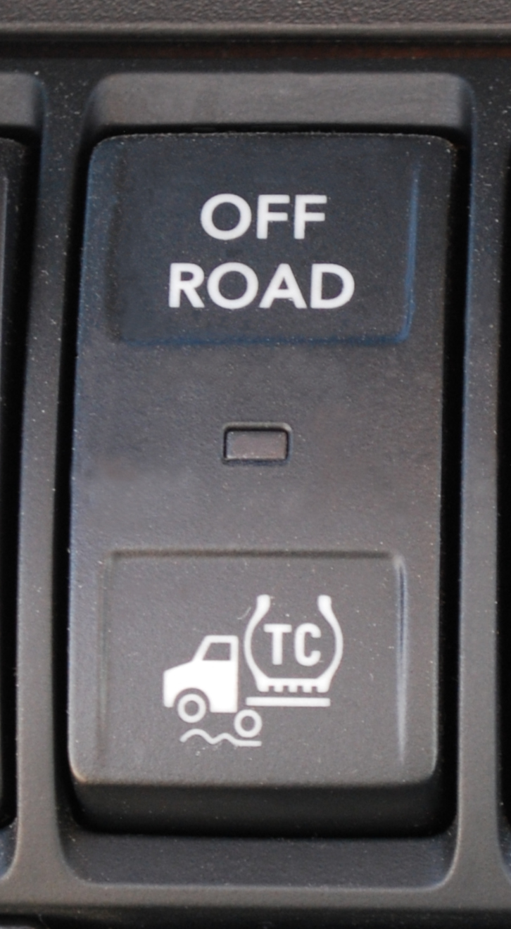
What is the Bendix® eTrac Automated Axle Load Transfer System?
An automated air suspension pressure transfer system used on 6x2 semi-tractors
Provides improved traction at low speeds
Pulling away on an inclined ramp
Slippery conditions such as mud or snow-covered surfaces
By activating the OFF ROAD dash switch, the driver can be proactive in anticipating any conditions needing extra traction

Slide 4
How does the Bendix® eTrac Automated Axle Load Transfer System work?
When the automatic traction control (ATC) OFF ROAD dash switch is OFF, the Bendix eTrac system is in “automatic” mode
Air pressure is transferred from the undriven axle to the driven axle without requiring manual input or drive action
Automatically disengages at vehicle speeds above 25 MPH or five (5) seconds after the ATC event has ended
http://www.bendix.com/en/products/etrac/etrac.jsp

Slide 5
Benefits of 6×2 with Bendix® etrac
A 6×2 configuration can offer significant savings and fuel economy improvements.
https://nacfe.org/technology/6x2-axles/
Fuel Efficiency | Weight | Maintenance | Stability
6x2 axles can offer an average fuel consumption improvement of 2.5% over 6x4 axles For a fleet averaging 8 miles per gallon (mpg), that's almost $1,100 in savings annually per vehicle Annual mileage per vehicle of 125,000 miles/year at diesel prices of $2.88/gallon as of 6/22/18 6x2 Axle Confidence Report, The North American Council for Freight Efficiency, July 2017. | 6×2 axles offer significant weight reduction because a tag axle weighs less than a driven axle Has no inter-axle driveline or rear differential Haul over 500 lbs. more freight by eliminating extra gearbox weight on 1 axle | eTrac automatically engages and disengages, reducing costs for drive axle or driveline maintenance and downtime Save up to $100 / year / per vehicle in maintenance costs with 6x2 axles 6x2 Axle Confidence Report, The North American Council for Freight Efficiency, July 2017. | Additional stability and control when operating in slippery or poor road conditions The tag axle cannot spin out because it is not powered by the engine Lateral force to keep the vehicle stable on its desired path

Slide 6
FREQUENTLY ASKED QUESTIONS
When does eTrac engage?
When ATC becomes active, the system will automatically perform the air bag transfer until the vehicle exceeds 25 MPH or five (5) seconds after the ATC event has ended.
What happens if the tractor is in semi-automatic mode?
When the driver activates the ATC OFF ROAD dash switch, the Bendix eTrac system goes into “semi-automatic” mode and the air bag air pressure transfer begins immediately. It automatically disengages when the ATC OFF ROAD dash switch is turned OFF or when the vehicle speed exceeds 10 MPH.
Does it require IROS, all axle spacings, 40K only?
E-Trac requires the ABS and suspension feature:
0004AZY AIR BRAKE ABS [Bendix Anti Lock Brake System] with Electronic Stability Program (6-Channel; 6 Sensor/6 Modulator) with Automatic Traction Control
0014UPZ SUSPENSION, REAR, AIR, TANDEM [International] Ride Optimized Suspension (IROS), 40,000-lb Capacity, 52" Axle Spacing, 9.25" Ride Height, with Shock Absorbers
Is the air pressure to the system limited?
Air pressure transfer to the driven axle airbags is automatically limited by the system. This pressure limit is determined by the vehicle OEM at installation and cannot be changed by a fleet.
What is the “normal automatic mode”?
When the OFF ROAD dash switch is NOT engaged, the system behaves just like a typical air suspension leveling system that adjusts for different loads by a mechanical leveling (height control) valve that adjusts all four rear suspension air bags as needed. The eTrac system is ready whenever the vehicle is moving at less than 25 MPH. https://www.manualshelf.com/manual/bendix-commercial-vehicle-systems/etrac-automated-air-pressure-transfer-system/manual-english/page-2.html
What is “pressure-limiting mode”?
When the OFF ROAD dash switch is NOT engaged, this mode of operation prevents system air pressure delivery to the drive axle suspension air bags above a pre-determined maximum pressure. The system will then — using the backfeed valve — permit the leveling valve to add air back into the tag axle suspension air bags as needed. https://www.manualshelf.com/manual/bendix-commercial-vehicle-systems/etrac-automated-air-pressure-transfer-system/manual-english/page-2.html

